Slide 1



D01. LMS - Library Management System

Slide 2

MEMBER
Quách Tấn Đạt-22102167
Huỳnh Gia Bảo-22118978
Đỗ Trần Quốc Anh-22113887
Nguyễn Văn Bảo Hoàn-22102144

Slide 3


01
Introduction
Title: Library Management System (LMS)
Purpose: The project was developed to automate the core processes of a library, including the management of books, readers, and borrowing/returning transactions.
Overview:

Slide 4
01
Introduction
Overview:
The system supports two primary user roles: Librarian and Reader.
Data is persistently stored in files, ensuring information security and durability.
The system features a user-friendly, command-line interface managed by the Menu class.

Slide 5
Problem Statement (SRS)
02
Problem
Manual library management is inefficient and prone to errors. Key issues include inaccurate record-keeping, difficulty in tracking overdue books, and slow processing of borrowing and returning transactions.

Slide 6
Functional Requirements (SRS)
User Management: The system must allow users to register, log in, and handle different permissions for Librarian and Reader accounts.
Book Management: The system must support adding, removing, updating, and searching for books.
Transaction Management: The system must record borrowing and returning history and automatically calculate overdue periods.
Reporting: The system must be able to generate statistical reports on book status and user activity.

Slide 7
UseCase Diagram
03

Slide 8
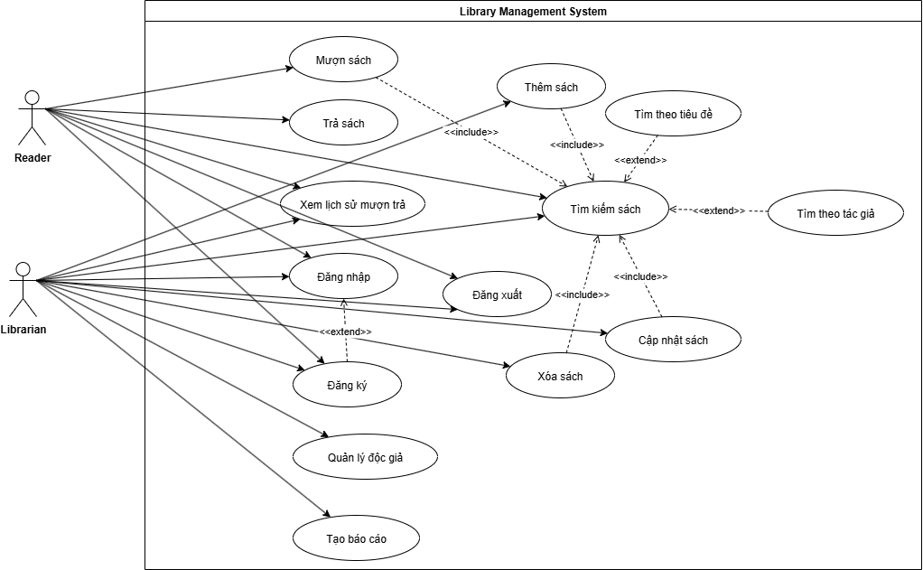

Slide 9
Sequence Diagram
04

Slide 10
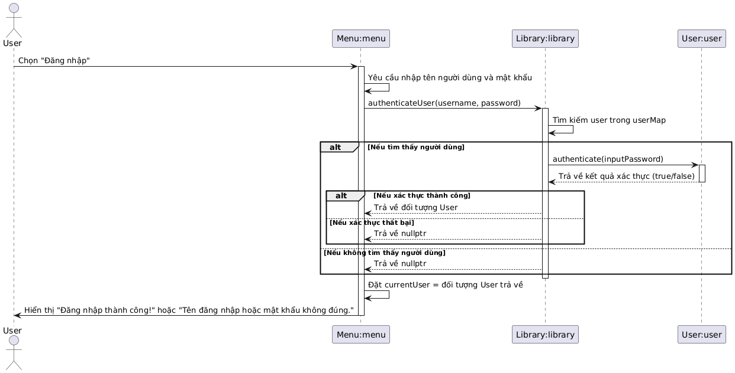
Sequence diagram of the login function

Slide 11
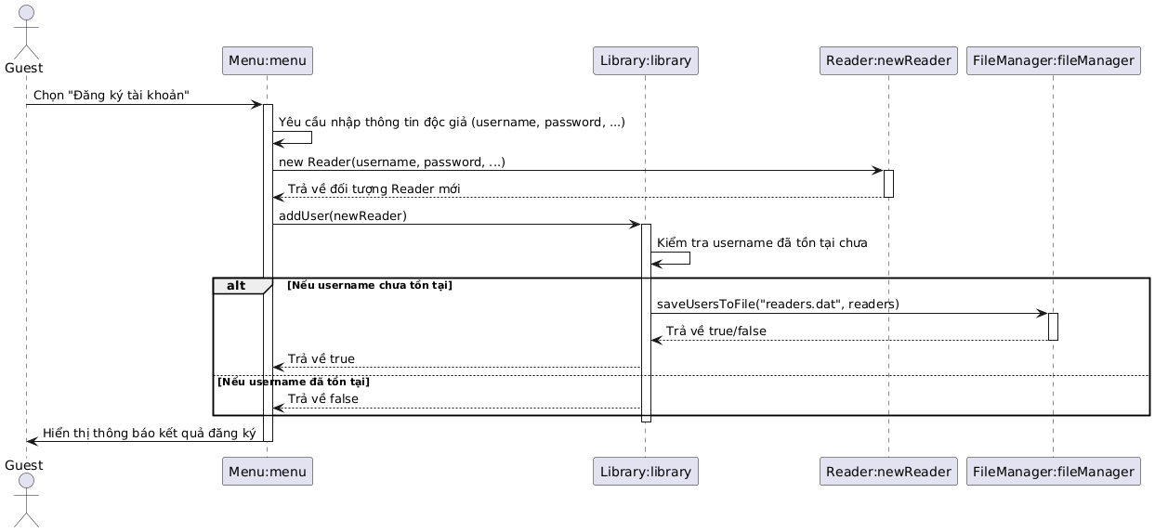
Sequence diagram of the registration function

Slide 12
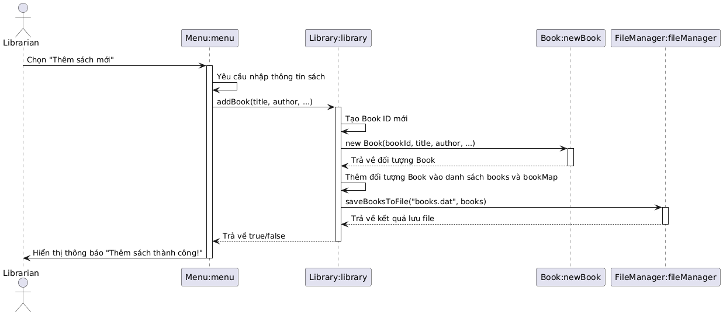
Sequence diagram of the new book addition function

Slide 13
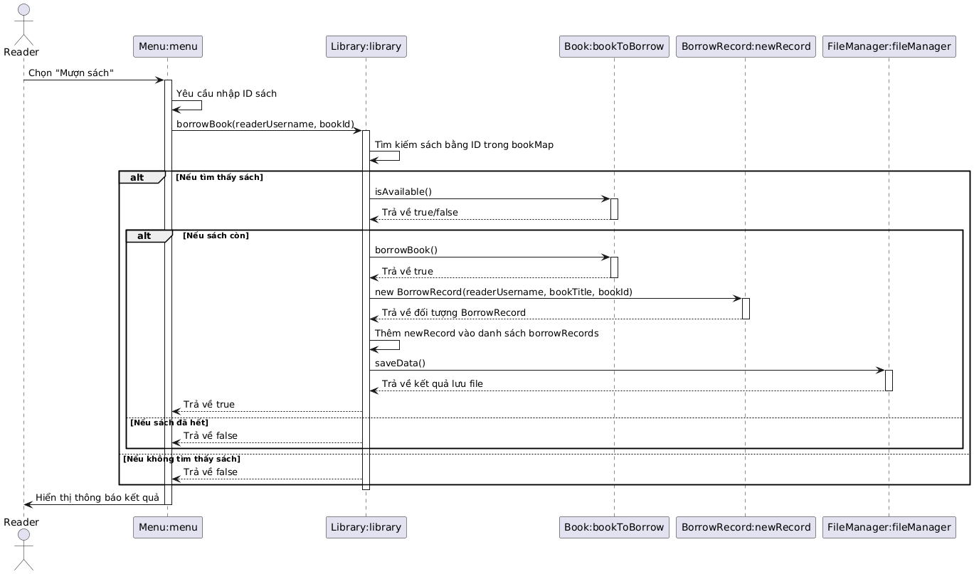
Sequence diagram of the book borrowing function

Slide 14
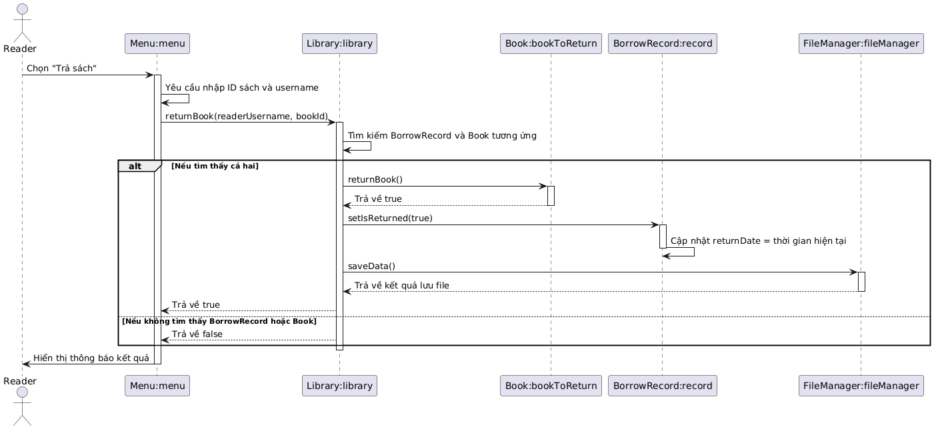
Sequence diagram of the book return function

Slide 15
Class Digram
05

Slide 16
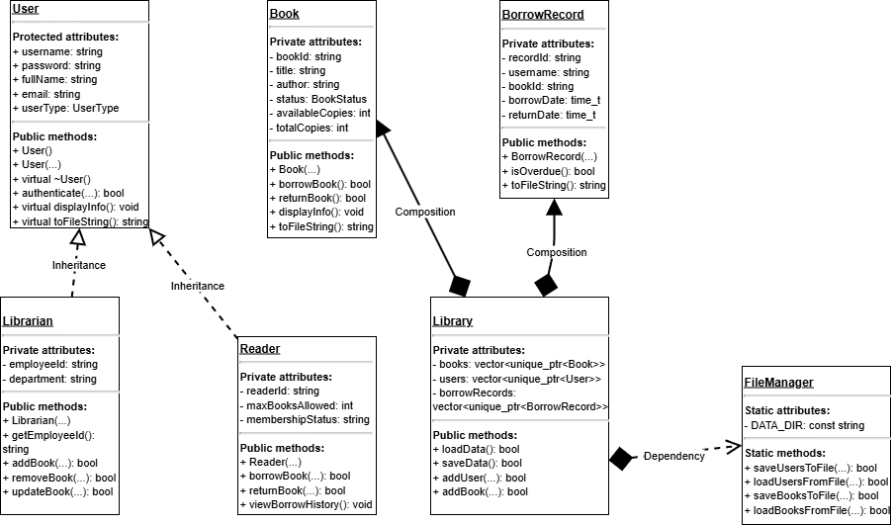

Slide 17
Class (detail)
06

Slide 18
CLASS USER
Model:
Meaning:
·The User class is an abstract base class that represents any user in the library system. It defines the common attributes and behaviors shared by both Librarian and Reader classes.

Slide 19
CLASS USER
Attributes
ousername (string): A unique login username.
opassword (string): The user's password.
ofullName (string): The user's full name.
oemail (string): The user's email address.
ouserType (enum UserType): The type of user (Librarian or Reader).

Slide 20
Relation
·Relationships with other classes: User has an Inheritance relationship with the Librarian and Reader classes. Both of these classes are a (is-a) User.
·Key Relationship: Librarian and Reader inherit publicly from User.

Slide 21
Main Flow (SD / Activity)
Activity Flow: The User class does not have an independent activity flow but participates in the system's core flows, particularly during authentication and information display.
Login Flow Participation: When the Library authenticates a user, it calls the authenticate() method of a User object through a pointer or reference.
Info Display Flow Participation: Methods like displayInfo() are called to show the user's detailed information.

Slide 22
Mapping: attributes / properties / methods / relations
·Attributes / Data Types:
·Methods / Relations:
ousername, password, fullName, email: Map to std::string.
ouserType: Maps to enum class UserType.
authenticate(const std::string&): Maps to a virtual method that is overridden in derived classes. However, in your code, this method is implemented in the base class, and derived classes do not override it, which is a simple design.
toFileString() and fromFileString(): Map to virtual methods for object serialization and deserialization, allowing data to be saved to and loaded from files.

Slide 23
Class Specification
·authenticate(const std::string& inputPassword)
Name: authenticate
Meaning: Checks if the provided password matches the object's stored password.
Default Value: N/A.
Parameters: inputPassword (of type const std::string&), the password entered by the user.
Return Value: bool. Returns true if the password matches, otherwise false.
·toFileString()
Name: toFileString
Meaning: Converts the object's data into a text string for saving to a file. Attributes are separated by the | character.
Default Value: N/A.
Parameters: N/A.
Return Value: std::string. Returns the formatted data string.

Slide 24
CLASS Librarian
Model:
Meaning:
The Librarian class represents a librarian in the system. It inherits from User and has its own specific management attributes and functions.

Slide 25
CLASS Librarian
Attributes
employeeId (string): The employee's unique ID.
department (string): The department the librarian works in.

Slide 26
Relation
Inheritance: Librarian inherits from User (Librarian is a User).
Aggregation: Librarian has an aggregation relationship with Book and Reader objects through its management methods. Specifically, a Librarian's methods receive Book and Reader vectors as parameters.

Slide 27
Main Flow (SD / Activity)
Activity Flow:
Add Book Flow: A Librarian calls the addBook() method of the Library class.
Report Flow: A Librarian calls the generateReports() method to create a statistical report.
Reader Management Flow: A Librarian calls reader management methods like manageReaders().

Slide 28
Mapping: attributes / properties / methods / relations
·Attributes / Data Types:
·Methods / Relations:
employeeId, department: Map to std::string.
displayInfo(): A virtual method overridden from User to display the librarian's specific details.
toFileString(): Overrides the method from User to include employeeId and department in the data string.

Slide 29
Class Specification
displayInfo()
Name: displayInfo
Meaning: Displays detailed information about the librarian, including the basic information from the User class and the specific attributes of Librarian.
Default Value: N/A.
Parameters: N/A.
Return Value: void.
generateReports(const std::vector<Book*>& books, const std::vector<Reader*>& readers)
Name: generateReports
Meaning: Creates and displays a statistical report about the number of books, book statuses, and number of readers.
Default Value: N/A.
Parameters: books (a constant reference to a vector of Book pointers), and readers (a constant reference to a vector of Reader pointers).
Return Value: void.

Slide 30
CLASS Reader
Model:
Meaning:
The Reader class represents a reader in the system. It inherits from User and has its own attributes and functions.

Slide 31
CLASS Reader
Attributes
Attributes:
readerId (string): The reader's unique ID.
maxBooksAllowed (int): The maximum number of books a reader can borrow.
membershipStatus (string): The status of the reader's membership ("ACTIVE", "SUSPENDED", "EXPIRED").

Slide 32
Relation
Inheritance: Reader inherits from User (Reader is a User).
Aggregation: Reader has an aggregation relationship with BorrowRecord (via Library) to view their borrowing history.

Slide 33
Main Flow (SD / Activity)
Activity Flow:
Borrow Book Flow: A Reader calls the borrowBook() function of the Library class.
Return Book Flow: A Reader calls the returnBook() function of the Library class.
View History Flow: A Reader calls the viewBorrowHistory() function to see their borrowing records.

Slide 34
Mapping: attributes / properties / methods / relations
·Attributes / Data Types:
·Methods / Relations:
readerId, membershipStatus: Map to std::string.
maxBooksAllowed: Maps to int.
displayInfo(): Overrides the method from User to display the reader's specific attributes.
toFileString(): Overrides the method from User to include readerId, maxBooksAllowed, and membershipStatus in the data string.

Slide 35
Class Specification
viewBorrowHistory() const
Name: viewBorrowHistory
Meaning: Displays a list of borrowing records for the current reader. This function interacts with Library to retrieve the data.
Default Value: N/A.
Parameters: N/A.
Return Value: void.
fromFileString(const std::string& data)
Name: fromFileString
Meaning: Reads data from a text string and assigns the values to the Reader object's attributes.
Default Value: N/A.
Parameters: data (of type const std::string&), the data string read from the file.
Return Value: void.

Slide 36
CLASS Book
Model:
Meaning:
The Book class represents a single book in the library.

Slide 37
CLASS Book
Attributes
bookId (string): The unique ID of the book.
title (string): The title of the book.
author (string): The author's name.
totalCopies (int): The total number of copies.
availableCopies (int): The number of available copies.
status (enum BookStatus): The status of the book (AVAILABLE, BORROWED, etc.).

Slide 38
Relation
Independent: Book is an independent class; it does not inherit from any other class.
Aggregation: The Library class aggregates Book objects and manages them.

Slide 39
Main Flow (SD / Activity)
Activity Flow:
Borrow Book Flow Participation: The Book's borrowBook() method is called by Library when a book is successfully borrowed.
Return Book Flow Participation: The returnBook() method is called when a book is returned.

Slide 40
Mapping: attributes / properties / methods / relations
·Attributes / Data Types:
·Methods / Relations:
status: Maps to enum class BookStatus.
category: Maps to enum class BookCategory.
lastModified: Maps to std::chrono::system_clock::time_point.
isAvailable(): A method to check the book's availability.
toFileString(), fromFileString(): Methods for converting book data to and from a string for file storage.

Slide 41
Class Specification
borrowBook()
Name: borrowBook
Meaning: Decrements the number of available copies of the book. If the number of copies reaches 0, the book's status is changed to BORROWED.
Default Value: N/A.
Parameters: N/A.
Return Value: bool. Returns true if the book was successfully borrowed, false otherwise.
returnBook()
Name: returnBook
Meaning: Increments the number of available copies. If the number of copies equals the total number of copies, the book's status is changed to AVAILABLE.
Default Value: N/A.
Parameters: N/A.
Return Value: bool. Returns true if the book was successfully returned, false otherwise.

Slide 42
CLASS BorrowRecord
Model:
Meaning:
The BorrowRecord class represents a transaction log of a book borrowing.

Slide 43
CLASS BorrowRecord
Attributes
recordId (string): The unique ID of the record.
username (string): The username of the reader.
bookId (string): The ID of the borrowed book.
borrowDate (time_t): The time the book was borrowed.
dueDate (time_t): The due date for the book return.
oisReturned (bool): The status of whether the book has been returned.

Slide 44
Relation
Independent: BorrowRecord is an independent class.
Aggregation: The Library class aggregates and manages all BorrowRecord objects.

Slide 45
Main Flow (SD / Activity)
Activity Flow: A BorrowRecord object is created in the book borrowing flow (borrowBook) and updated in the book return flow (returnBook).

Slide 46
Mapping: attributes / properties / methods / relations
Attributes / Data Types:
Methods / Relations:
borrowDate, returnDate, dueDate: Map to time_t for efficient time storage.
isReturned: Maps to bool.
isOverdue(): A method to check if a record is overdue.
toFileString(), fromFileString(): Methods for saving and loading data to and from files.

Slide 47
Class Specification
isOverdue() const
Name: isOverdue
Meaning: Checks if the book in this record is overdue. It compares the current time with the dueDate.
Default Value: N/A.
Parameters: N/A.
Return Value: bool. Returns true if the book is overdue and not yet returned, otherwise false.
fromFileString(const std::string& line)
Name: fromFileString
Meaning: Parses a data string (read from a file) and assigns the values to the record's attributes.
Default Value: N/A.
Parameters: line (of type const std::string&), the data string containing the record information.
Return Value: bool. Returns true if parsing is successful, false if the string is invalid.

Slide 48
CLASS Library
Model:
Meaning:
The Library class is the central part of the entire system. It manages all other objects such as User, Book, and BorrowRecord.

Slide 49
CLASS Library
Attributes
books (vector unique_ptr<Book>): Holds all books in the library.
users (vector unique_ptr<User>): Holds all users.
borrowRecords (vector unique_ptr<BorrowRecord>): Holds all borrowing records.
userMap and bookMap (unordered map): Used for quick lookup of objects by their IDs.

Slide 50
Relation
Composition: Library has a strong composition relationship with Book, User, and BorrowRecord. This is shown by the use of std::unique_ptr to manage their lifetimes.
Dependency: Library depends on FileManager to save and load data from files.

Slide 51
Main Flow (SD / Activity)
Activity Flow:
Initialization: In main(), a Library object is created.
Data Loading: Upon startup, Library automatically loads data from files using the loadData() method.
Management: Library contains the core methods for functions like addBook(), borrowBook(), returnBook(), and authenticateUser().

Slide 52
Mapping: attributes / properties / methods / relations
Attributes / Data Types:
Methods / Relations:
bookIdCounter, readerIdCounter: Map to static int for unique ID generation.
books, users, borrowRecords: Map to std::vector of std::unique_ptr.
loadData() and saveData(): Map to the main methods for interacting with FileManager.
initializeMaps(): Maps to a private method to build the unordered_maps after data is loaded.

Slide 53
Class Specification
authenticateUser(const std::string& username, const std::string& password)
Name: authenticateUser
Meaning: Authenticates a user using a username and password. It finds the user by username and then calls the authenticate() method of that object.
Default Value: N/A.
Parameters: username (string) and password (string).
Return Value: User* pointer. Returns a pointer to the User object if authentication succeeds, otherwise nullptr.
saveData() const
Name: saveData
Meaning: Saves all library data (books, users, borrow records) to their corresponding files by calling FileManager.
Default Value: N/A.
Parameters: N/A.
Return Value: bool. Returns true if the save is successful, otherwise false.

Slide 54
CLASS File Manager
Model:
Meaning:
The file manager class is a static utility class responsible for all file-reading and writing operations. It ensures data persistence.

Slide 55
CLASS File Manager
Attributes
DATA_DIR (const string): The path to the data directory.
lastError (string): Stores the last error message.

Slide 56
Relation
Dependency: The Library class depends on FileManager. FileManager also depends on other data classes like User, Book, and BorrowRecord to handle data strings.

Slide 57
Main Flow (SD / Activity)
Activity Flow:
Load Data Flow: When Library::loadData() is called, FileManager reads the data files (users.dat, books.dat, etc.) and returns the corresponding objects.
Save Data Flow: When Library::saveData() is called, FileManager writes data from the objects into the files.

Slide 58
Mapping: attributes / properties / methods / relations
Attributes / Data Types:
Methods / Relations:
DATA_DIR: Maps to a string constant.
All methods of FileManager are static, which means they can be called directly without creating an object.

Slide 59
Class Specification
saveBooksToFile(const std::string& filename, const std::vector<std::unique_ptr<Book>>& books)
Name: saveBooksToFile
Meaning: Writes a list of book objects to a file.
Default Value: N/A.
Parameters: filename (file path) and books (a constant reference to a vector of books).
Return Value: bool. Returns true if the save is successful, false on error.
splitString(const std::string& str, char delimiter)
Name: splitString
Meaning: Splits a string into a vector of substrings based on a delimiter character. This is a crucial utility function used for parsing file data.
Default Value: N/A.
Parameters: str (the string to split) and delimiter (the character to split by).
Return Value: std::vector<std::string>.

Slide 60
CLASS Menu
Model:
Meaning:
The Menu class is responsible for handling the user interface, displaying options, and processing user input.

Slide 61
CLASS Menu
Attributes
library (reference): A reference to the Library object to access system functions.
currentUser (pointer): A pointer to the currently logged-in User object.

Slide 62
Relation
Aggregation: Menu has an aggregation relationship with both Library and User. It holds a reference to Library and a pointer to the current User.

Slide 63
Main Flow (SD / Activity)
Activity Flow:
Main Loop (run()): Menu contains the main while loop to continuously display the menu to the user.
Menu Display: The displayed menu depends on the currentUser's state, showing either the main menu, librarian menu, or reader menu.
Choice Handling: The handle...Choice() methods process the user's selection and call the corresponding methods in the Library class.

Slide 64
Mapping: attributes / properties / methods / relations
Attributes / Data Types:
Methods / Relations:
currentUser: Maps to User*.
show...Menu(): Methods to display the different menus.
authenticateUser(): A method to handle the login flow.

Slide 65
Class Specification
run()
Name: run
Meaning: The main method to start the menu loop, continuously displaying options and processing user input until the user chooses to exit.
Default Value: N/A.
Parameters: N/A.
Return Value: void.
getValidChoice(int min, int max)
Name: getValidChoice
Meaning: Prompts the user for an integer and validates that it falls within a specified range (min to max).
Default Value: N/A.
Parameters: min (int) and max (int), defining the valid range for the choice.
Return Value: int. Returns the user's valid choice.

Slide 66
CLASS Utils
Model:
Meaning:
The Utils class is a static utility class. It contains helper functions that do not belong to any specific object, helping to simplify the codebase and avoid code duplication.

Slide 67
CLASS Menu
Attributes
It has no object attributes, only static attributes to support its static functions.

Slide 68
Relation
Independent: Utils is a completely independent class.
Dependency: Other classes in the system like Book, Librarian, and FileManager depend on Utils to perform string manipulation, time handling, and other system-level tasks.

Slide 69
Main Flow (SD / Activity)
Activity Flow:
Utils methods are called directly by other classes to support core functionalities. For example, FileManager uses Utils::splitString() to parse data from files.

Slide 70
Mapping: attributes / properties / methods / relations
Attributes / Data Types:
Methods / Relations:
All methods are static.
toUpper(), toLower(), trimString(), split(): String manipulation methods.
formatDate(), getDaysOverdue(): Time and date handling methods.
getPlatformName(): A method to get platform information.

Slide 71
Class Specification
toLower(const std::string& str)
Name: toLower
Meaning: Converts all characters in a string to lowercase.
Default Value: N/A.
Parameters: str (constant reference), the input string.
Return Value: std::string. Returns the new lowercase string.
split(const std::string& str, const std::string& delimiter)
Name: split
Meaning: Splits a string into a vector of substrings based on a delimiter string. This is a very powerful utility function.
Default Value: N/A.
Parameters: str (the string to split) and delimiter (the string to split by).
Return Value: std::vector<std::string>.

Slide 72
Thank you very much!

